Slide 1
Machine Learning: a hands-on experience
UniCredit Quant Community
Gabriele Bonomi Boseggia, Fabio Colombo, Luca Mammi
Milan, June 14th, 2018

Slide 2
Welcome and thanks for being here!
While we start talking, let's get the systems up and running:
If you followed the instructions and want to run Jupyter Notebooks locally, please download the zip file with today's notebooks at one of these two links
OR
If you want to follow the lessons online please follow one of these links
goo.gl/jBryjq | goo.gl/VRtidt
goo.gl/9574kJ | goo.gl/jSWBA4

Slide 3

Welcome and thanks for being here!
For any questions you have today, please join us on sli.do

Slide 4
AGENDA
Session 1: Introduction to Machine Learning
an introduction to Machine Learning
an introduction to the necessary R tools
some Machine Learning algorithms and models
…with code – hands on!
Session 2: Model Selection and Validation
more Machine Learning models
Model Selection and Validation
Model Training Strategies and Hyperparameter Tuning
…with code – hands on!
Session 3: Neural Networks
an introduction to Neural Networks (w/ code, hands on!)
some Deep Learning examples
…with code – hands on!

Slide 5
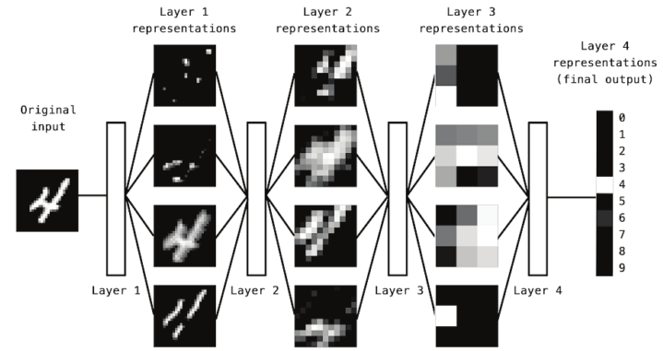
What is Deep Learning?
Deep Learning
is a subfield of machine learning
it consists of successive layers of representations
Such representations are all automatically learnt from data

Slide 6
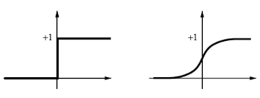








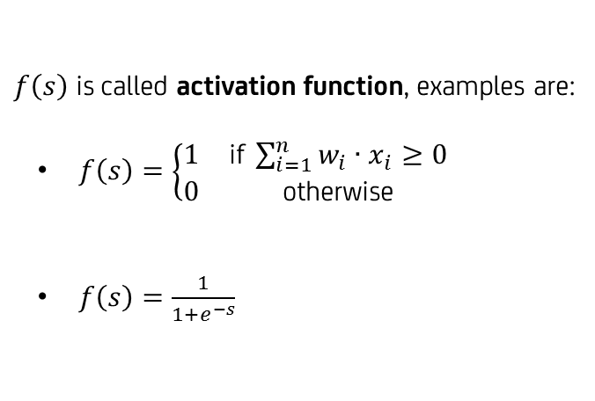



Neural Networks are the main models for Deep Learning
These representations are (almost always) learned via models called Neural Networks
The main block for a Neural Network was initially inspired by a neuron and is called a perceptron
INPUT
WEIGHTS
OUTPUT
$$s=\sum_{i=1}^{n}{w_{i}∙x_{i}}$$
$$y=f\left(s\right)=f\left({\left[\begin{matrix}w_{1} \\ w_{2} \\ ⋮ \\ w_{n}\end{matrix}\right]}^{T}∙\left[\begin{matrix}x_{1} \\ x_{2} \\ ⋮ \\ x_{n}\end{matrix}\right]\right)=w^{T}x$$
$$x_{1}$$
$$w_{1}$$
$$x_{2}$$
$$w_{2}$$
$$y$$
$$s$$
$$f\left(s\right)$$
$f\left(s\right)$ is called activation function, examples are:
$f\left(s\right)=\left\{\begin{matrix}1 & \text{i}\text{f} \sum_{i=1}^{n}{w_{i}∙x_{i}}≥0 \\ 0 & \text{o}\text{therwise}\end{matrix}\right.$
$f\left(s\right)=\frac{1}{1+e^{−s}}$
$$⋮$$
$$w_{n}$$
$$x_{n}$$
Apart from initial and basic inspiration, deep learning models are not models of the brain!

Slide 7
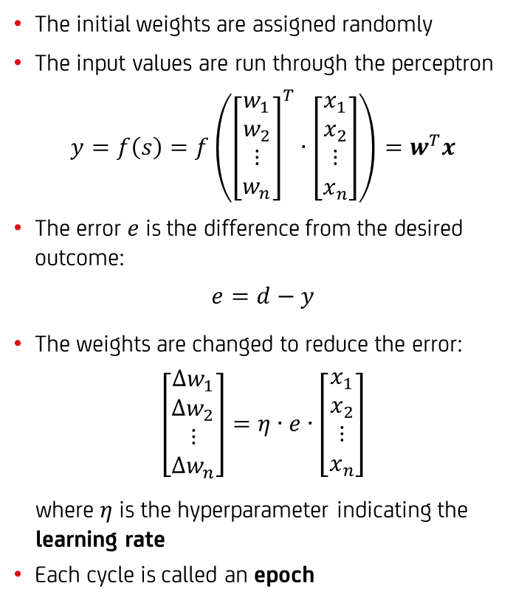
The single layer algorithm
Here's how it works:
The initial weights are assigned randomly
The input values are run through the perceptron
$$y=f\left(s\right)=f\left({\left[\begin{matrix}w_{1} \\ w_{2} \\ ⋮ \\ w_{n}\end{matrix}\right]}^{T}∙\left[\begin{matrix}x_{1} \\ x_{2} \\ ⋮ \\ x_{n}\end{matrix}\right]\right)=w^{T}x$$
The error $e$ is the difference from the desired outcome:
$$e=d−y$$
The weights are changed to reduce the error:
$$\left[\begin{matrix}{Δw}_{1} \\ Δw_{2} \\ ⋮ \\ {Δw}_{n}\end{matrix}\right]=η∙e∙\left[\begin{matrix}x_{1} \\ x_{2} \\ ⋮ \\ x_{n}\end{matrix}\right]$$
where $η$ is the hyperparameter indicating the learning rate
Each cycle is called an epoch
FORWARD PROPAGATION
INPUT
WEIGHTS
OUTPUT
$$x_{1}$$
$$w_{1}$$
$$x_{2}$$
$$w_{2}$$
$$y$$
BACKWARD PROPAGATION
$$s$$
$$f\left(s\right)$$
$$⋮$$
$$w_{n}$$
$$x_{n}$$
The Perceptron Convergence Theorem says that a perceptron will converge if the classes are linearly separable, regardless of the learning rate

Slide 8

















The Multi-Layer Perceptron
If classes are not linearly separable, we must add layers
$$h_{j}=f^{h}\left({\left[\begin{matrix}w_{1,j}^{x} \\ w_{2,j}^{x} \\ ⋮ \\ w_{n,j}^{x}\end{matrix}\right]}^{T}∙\left[\begin{matrix}x_{1} \\ x_{2} \\ ⋮ \\ x_{n}\end{matrix}\right]\right), j=1…m$$
$$y=f^{y}\left({\left[\begin{matrix}w_{1}^{h} \\ w_{2}^{h} \\ ⋮ \\ w_{m}^{h}\end{matrix}\right]}^{T}∙\left[\begin{matrix}h_{1} \\ h_{2} \\ ⋮ \\ h_{m}\end{matrix}\right]\right)$$
Here it gets tricky…
We can define a loss function $J\left(w\right)$ to measure the distance of the predictions from the desired outcome
The errors must be backward propagated to each unit, by minimizing the loss function
Since convergence is not ensured, we must do so in small steps
FORWARD PROPAGATION
INPUT
LAYER
HIDDEN
LAYER
OUTPUT
LAYER
$$x_{1}$$
$$w_{1,1}^{x}$$
$$h_{1}$$
$$w_{1,2}^{x}$$
$$w_{1}^{h}$$
$$x_{2}$$
$$⋮$$
$$h_{2}$$
$$w_{2}^{h}$$
$$y$$
$$⋮$$
$$⋮$$
BACKWARD PROPAGATION
$$w_{m}^{h}$$
$$x_{n}$$
$$w_{n,m}^{x}$$
$$h_{m}$$

Slide 9
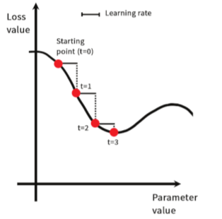
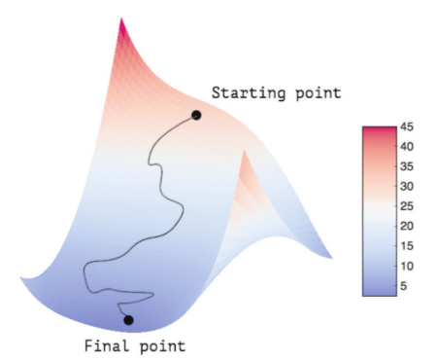
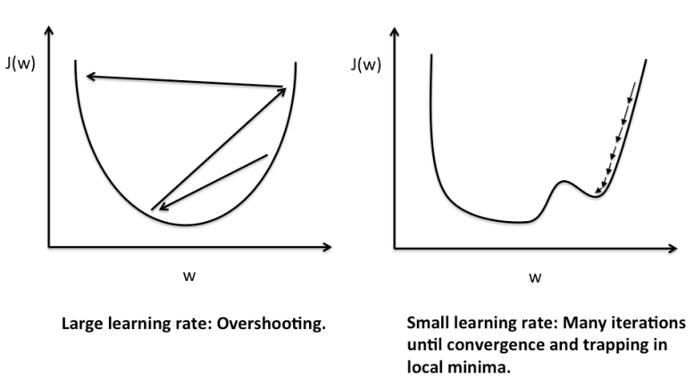
Gradient Based Optimization
The training loop is a step in the gradual adjustment of the weights through a feedback signal
The loss function is minimized using a well known iterative optimization algorithm: gradient descent
The learning rate hyperparameter plays a vital role in the convergence of the algorithm

Slide 10
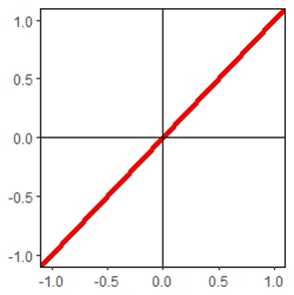
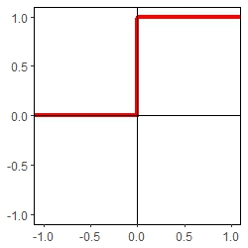
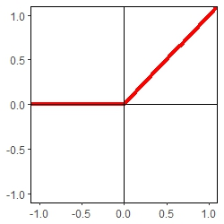
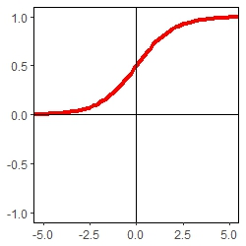
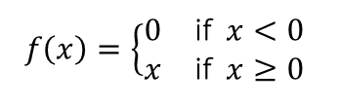
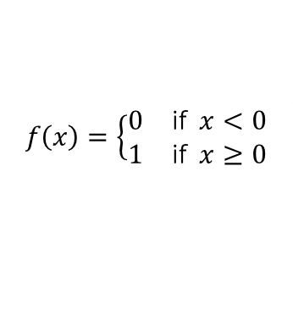

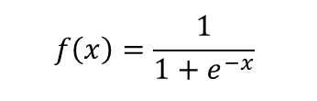
A few examples of activation functions
Different activation functions have different properties
Different activation functions can be used for different layers and for different problems
Linear
Binary Step
Rectified Linear Unit (ReLU)
Sigmoid
$$f\left(x\right)=x$$
$f\left(x\right)=\left\{\begin{matrix}0 & \text{i}\text{f} x<0 \\ 1 & \text{i}\text{f} x≥0\end{matrix}\right.$
$$f\left(x\right)=\left\{\begin{matrix}0 & \text{i}\text{f} x<0 \\ x & \text{i}\text{f} x≥0\end{matrix}\right.$$
$$f\left(x\right)=\frac{1}{1+e^{−x}}$$

Slide 11

Time to get our hands dirty
Let's try to build some Neural Networks
Convolutional Neural Networks can be used for image recognition
Recurring Neural Networks can be used for text recognition
The process of fighting overfitting is called regularization
Hands on the code!
3_1_NNIntro.ipynb
Hands on the code!
3_2_CNN.ipynb
Hands on the code!
3_3_RNN.ipynb
Hands on the code!
3_4_Regularization.ipynb

